Slide 1
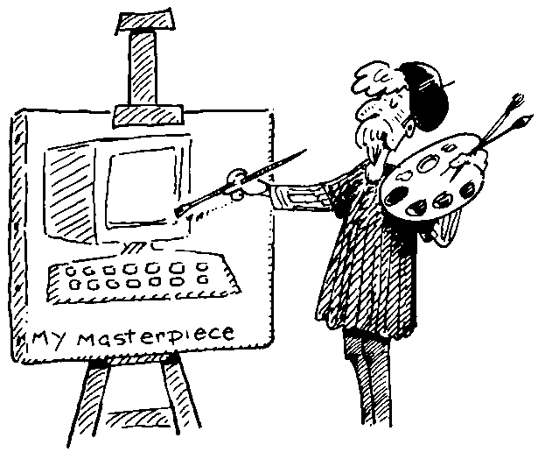
Understanding Users

Slide 2
Know the User - User Model
Representation of the users of a system
Models to aid design - User profiling - create a simple UM
Part of requirements elicitation
User centred design must involve users
User profiling helps identify users

Slide 3
Know the User?
Know your audience
Who will be using the product?
Age - Tastes - Expectations - Experience
Gender - Job -
Education - use of language
What constraints do these things impose?
How will it affect design?

Slide 4
Usage
Know your environment - where?
Home use
Factory use
Internet or network use
School - College - University
Viewed and controlled by a single person?
Projected or viewed on screen
Time of day
How often - how long for
What constraints will these impose

Slide 5
Environment
Noisy - interfere with sound - concentration
Quiet - library or classroom
Very bright - outdoors - unpredictable
Very dark
Projected at times (need to set different colours)
Used on laptop?

Slide 6
Technology
How long will the product be usable before it
needs an upgrade (information)
hardware change makes it obsolete
Does the project need managing once it is released?
Maintenance
Bug fixing
Updates

Slide 7
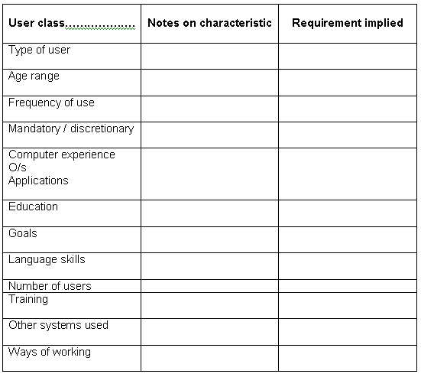

Slide 8
Sample question
Aftab poultry farm is developing a software for farmers. Farmers got no idea about computer and previously did not use any software. Their age range is 25-60. They don’t know any other language apart from Bangla. They will use this system as primary user where they will input the detail information of livestock at the end of the day. [Create the user profile]

Slide 9
Sample question
Ann is one of the curator of a museum. She is 33 years old. She got 8 colleagues who are older than her but not more than age 45. Her responsibility is to input the museum collection in a document. Museum is going to create a software for Ann and her colleagues. Every time museum receive any item, Ann or her colleagues are going to input them in a system. They have good command in English language. After 7 p.m they are not going to input any data in the system. [Create the user profile]

